Slide 1
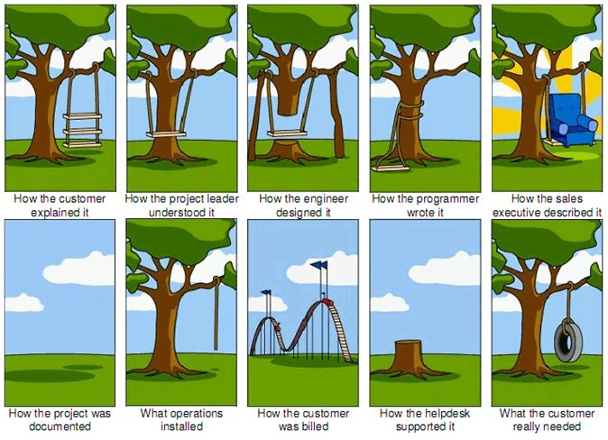

Slide 2
SOFTWARE PROCESS

Slide 3
Software Process
Set of activities and associated results that produce a software product.

Slide 4
GENERIC ACTIVITIES
Specification
Development
Validation
Evolution

Slide 5
SPECIFICATION
customers and engineers define the software to be produced and the constraints on its operation
what the system should do and its development constraints
DEVELOPMENT
Software is designed and programmed
VALIDATION
software is checked to ensure that it is what the customer requires
EVOLUTION
software is modified to adapt it to changing customer and market requirements

Slide 6
PROJECT
Complete procedure of software development from requirement gathering to testing and maintenance carried out according to the execution methodologies in a specified period of time to achieve intended software product.

Slide 7
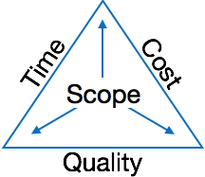

Slide 8
Software project Management Activities
Project Planning
Scope Management
Project Estimation

Slide 9
PROJECT PLANNING
It is a set of multiple processes, which facilitates software production
Performed before the production of software actually starts

Slide 10
SCOPE MANAGEMENT
Define the scope
Decide its verification and control
Divide the project into various smaller parts for ease of management.
Verify the scope
Control the scope by incorporating changes to the scope

Slide 11
project ESTIMATION
Software size estimation
Effort estimation
Time estimation
Cost estimation

Slide 12
PROJECT SCHEDULING
Break down the project tasks into smaller and manageable form
Find out various tasks and correlate them
Estimate time frame required for each task
Divide time into work-units
Assign adequate number of work-units for each task
Calculate total time required for the project from start to finish

Slide 13
PROJECT RISK MANAGEMENT
Identification
Categorize
Manage
Monitor

Slide 14
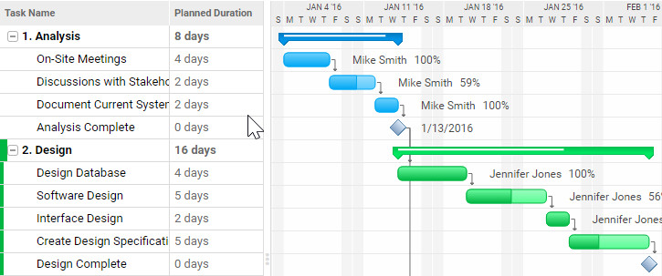
PROJECT MANGEMENT TOOLS
Gantt Chart

Slide 15
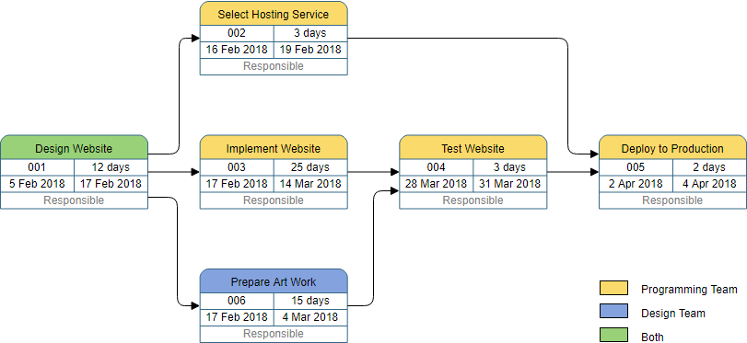
PERT Chart

Slide 16
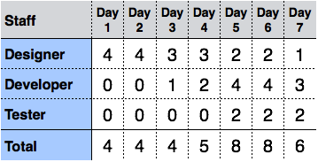
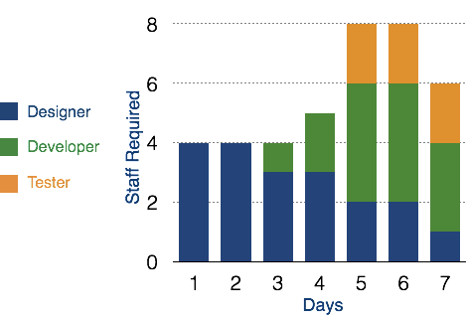
RESOURCE HISTOGRAM

Slide 17
Critical path analysis
Identifies interdependent tasks in the project
Helps to find out the shortest path or critical path to complete the project successfully Like PERT diagram, each event is allotted a specific time frame

Slide 18
CAPABILITY MATURITY MODEL(CMM)
CMM is a method to evaluate and measure the maturity of the software development process of an organization.
CMM was originally developed for Software Development and Maintenance but later it was developed for
Systems Engineering
Supplier Sourcing
Integrated Product and Process Development
People CMM
Software Acquisition

Slide 19
CMM measures the maturity of the software development process on a scale of 1 to 5
Level One :Initial
Level Two: Repeatable
Level Three: Defined
Level Four: Managed
Level Five: Optimizing

Slide 20
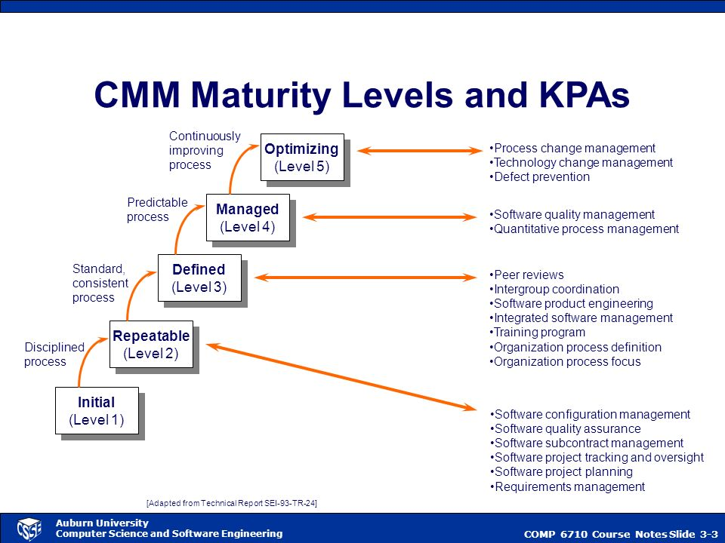

Slide 21
WATERFALL MODEL
The Waterfall Model was the first Process Model to be introduced
Easy to understand and use
It is also referred to as a linear-sequential life cycle model
Each phase is signed off before moving to the next

Slide 22
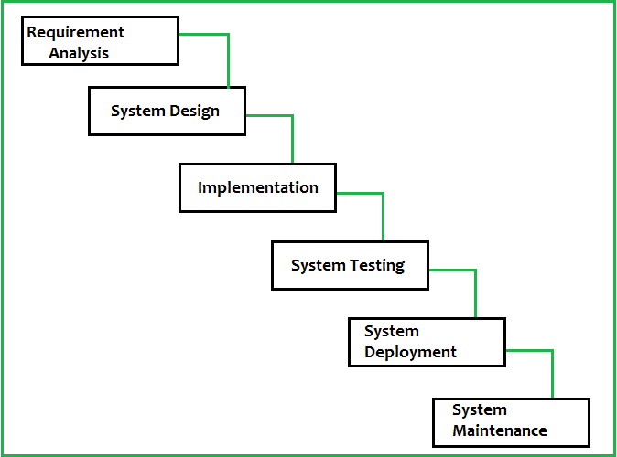

Slide 23
APPLICATION
Requirements are very well documented, clear and fixed
Product definition is stable
Technology is understood and is not dynamic
There are no ambiguous requirements
Ample resources with required expertise are available to support the product
The project is short

Slide 24
PROS
Simple and easy to understand and use
Easy to manage due to the rigidity of the model. Each phase has specific deliverables and a review process
Phases are processed and completed one at a time.
Works well for smaller projects where requirements are very well understood
Clearly defined stages
Well understood milestones
Easy to arrange tasks
Process and results are well documented

Slide 25
CONS
High amounts of risk and uncertainty
Difficult to manage complex project
Poor model for long and ongoing projects
It is difficult to measure progress within stages
Cannot accommodate changing requirements
Adjusting scope during the life cycle can end a project
Integration is done as a "big-bang” at the very end, which doesn't allow identifying any technological or business bottleneck or challenges early

Slide 26
Requirements are very well known
Product definition is stable
Technology is well understood
New version of an existing product
Porting an existing product to a new platform
Large organization with structured cross-functional teams
Communication channels are well established within the organization and with the customer as well

Slide 27
INCREMENTAL MODEL
The software is divided into separate modules(components) and each of those modules have separate set of water fall activities including requirement gathering and analysis design implementation deployment ad maintenance.

Slide 28
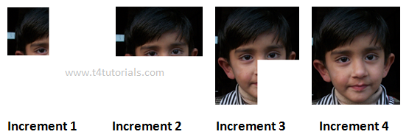

Slide 29
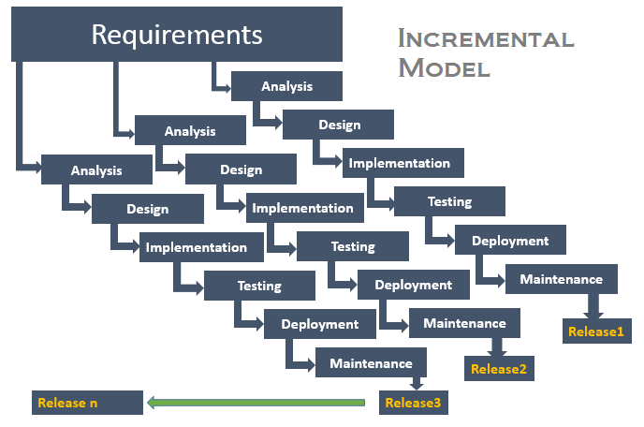

Slide 30
pros
Customer feedback is received after the delivery of each component
Risk of requirement change is reduces
More flexible
easy to test and debug
Give quick result

Slide 31
cons
Need proper plan to integrate the components
Need a proper design to integrate the components
More expensive as compared to water fall model

Slide 32
SPIRAL MODEL
The spiral model is a risk-driven software development process model. Based on the unique risk patterns of a given project, the spiral model guides a team to adopt elements of one or more process models such as incremental, waterfall, or evolutionary prototyping.
The development team in Spiral-SDLC model starts with a small set of requirement and goes through each development phase for those set of requirements.

Slide 33
WHEN??????
When project is large
When releases are required to be frequent
When creation of a prototype is applicable
When risk and costs evaluation is important
For medium to high-risk projects
When requirements are unclear and complex
When changes may require at any time
When long term project commitment is not feasible due to changes in economic priorities

Slide 34
Additional functionality or changes can be done at a later stage
Cost estimation becomes easy as the prototype building is done in small fragments
Continuous or repeated development helps in risk management
Development is fast and features are added in a systematic way
There is always a space for customer feedback

Slide 35
Risk of not meeting the schedule or budget
It works best for large projects only also demands risk assessment expertise
For its smooth operation spiral model protocol needs to be followed strictly
Documentation is more as it has intermediate phases
It is not advisable for smaller project, it might cost them a lot

Slide 36
